Slide 1
Status of Maternal & Child health in Arizona
Rep. Pamela Powers Hannley
LD9 Meeting, July 23, 2019

Slide 2
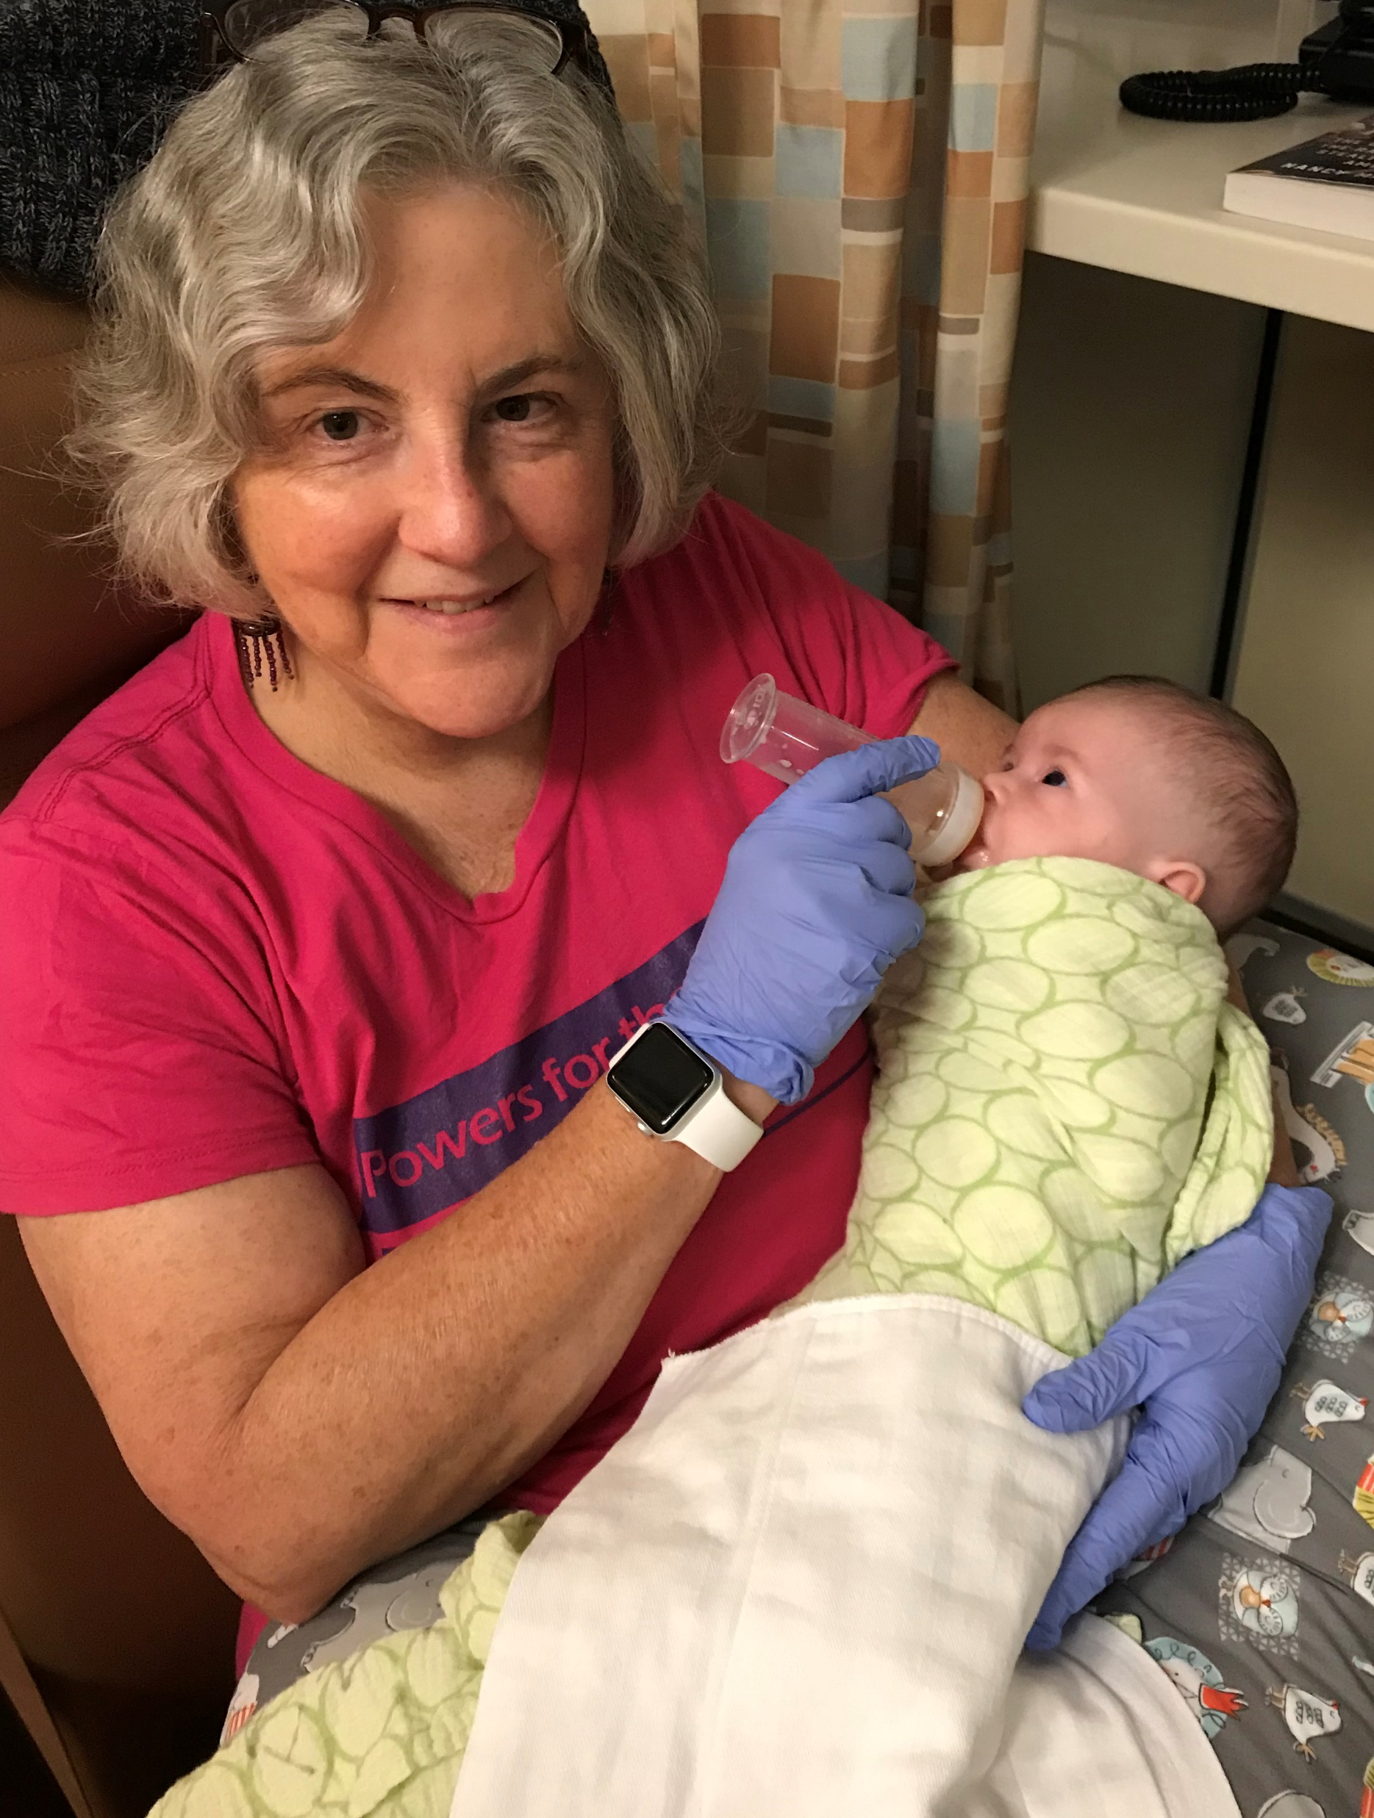

The NICU to now

Slide 3
Maternal & Child Health in Arizona
Too many Moms are dying from pregnancy-related causes.
Too many babies are dying.
Too many babies are born prematurely or with low birth weight.
Too many babies are born with birth defects.
Too many Moms don’t get adequate prenatal care.
MY HUNCH:
The face of premature birth in Arizona is young, brown and rural

Slide 4
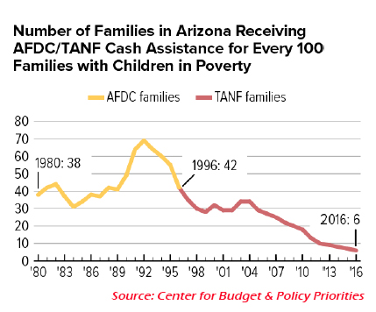
Only 6% of Arizonans eligible for tanf get it!
Arizona should increase TANF to the full five years.

Slide 5
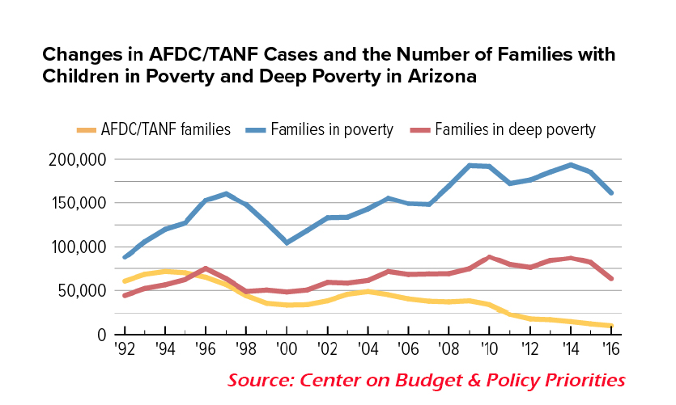
TANF is not keeping up with poverty
Single Moms and their children are most likely to live in poverty.

Slide 6
Maternal & Child Health in Arizona
Compared to other states, Arizona ranks in the 40s on overall policies related to the health of women and children.
It also ranks near the bottom on:
  #46 Availability of publicly funded women’s health services
  #41 Children with health insurance
  #47 Concentrated “disadvantage”
  #47 Intimate partner violence
  Source: America’s Health Rankings

Slide 7
Maternal & Child Health in Arizona
Annie E. Casey Foundation also ranks Arizona near the bottom
  #46 Overall child well-being
  #43 Economic well-being
  #46 Education
  #35 Health (Medicaid Expansion, Kids Care, low smoking rate)
  #46 Family and community
  2019 Kids Count Data Book

Slide 8
Maternal Death Nationwide
Maternal death in US increased 26.6% between 2000-2014.
  Worldwide maternal death is decreasing in other high-income countries in North America and Western Europe.
Vast geographic and racial differences in maternal and child health nationwide.
Maternal death is death within 42 days of end of pregnancy (not abortion)
  California 4.5 deaths per 100,000 live births
  Georgia, Louisiana and Indiana have 10x that of California.
  Arizona is #25 with 18.8 maternal deaths per 100,000 (more than 4x California).
  Arizona has collected maternal death data for about 10 years but ignored it since 2015. The Legislature voted to look at new maternal death data in 2019.

Slide 9
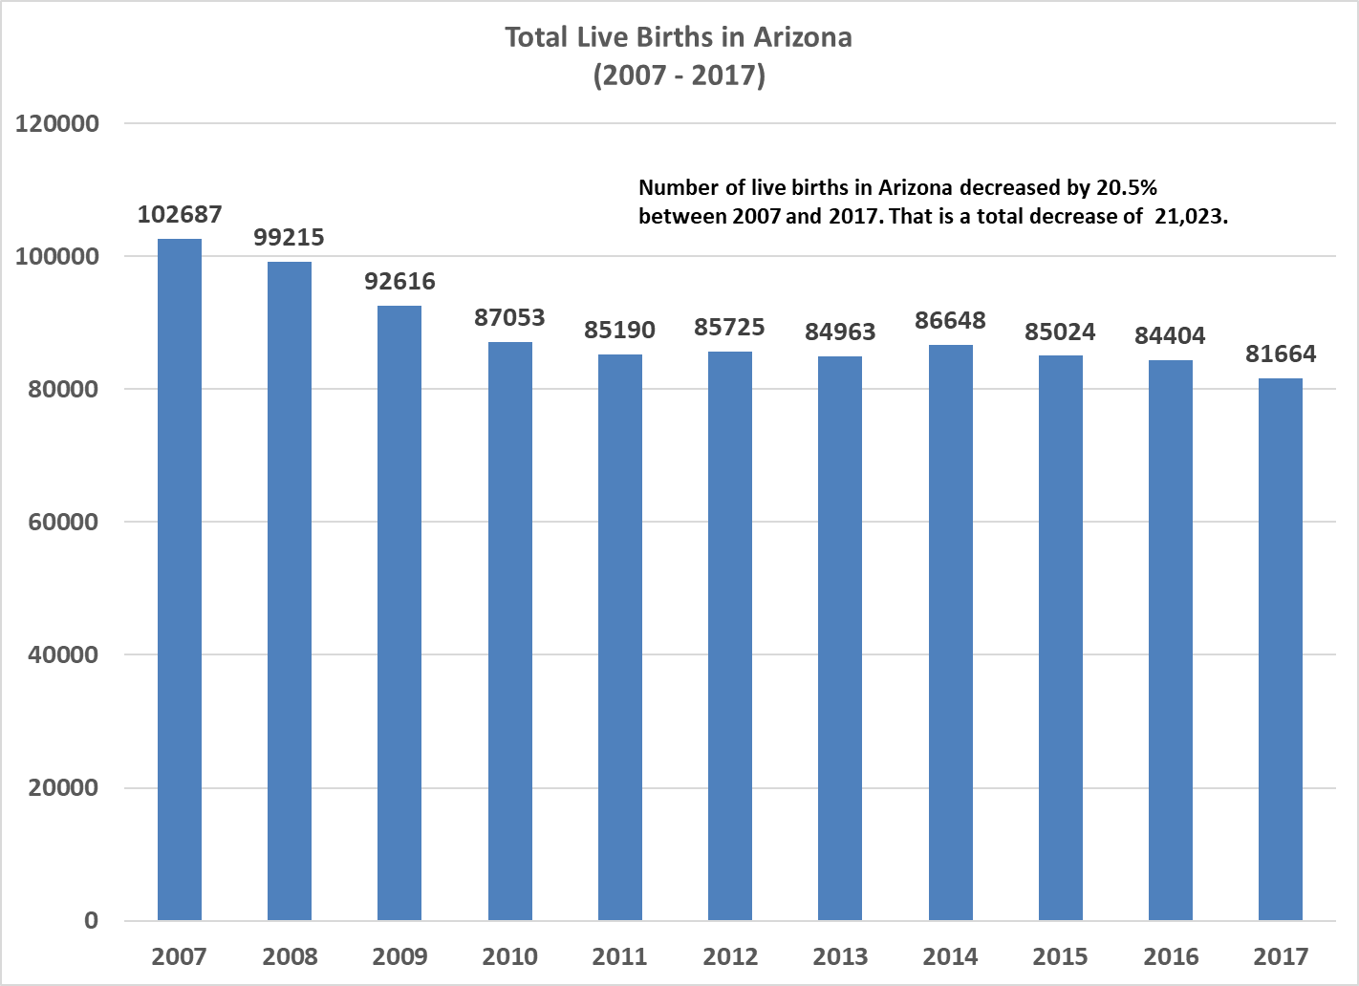
Live
Births by year

Slide 10
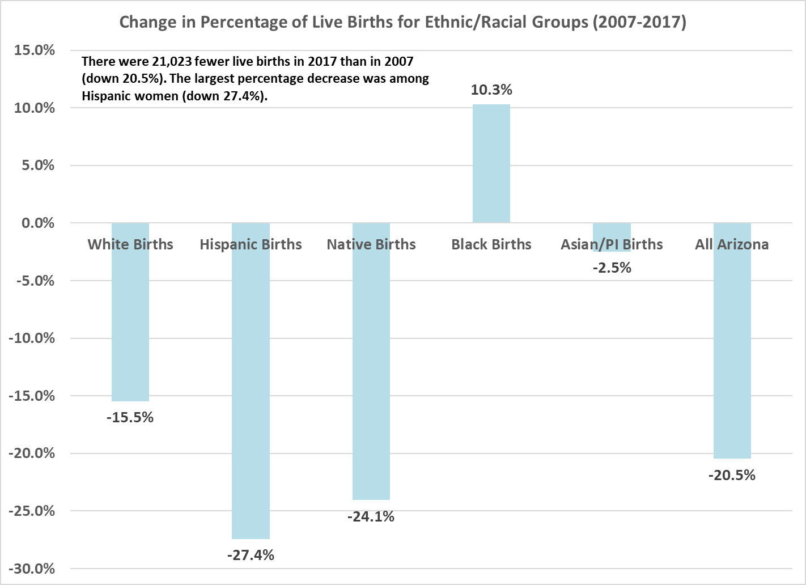
Live Births down 20.5%
102,687 in 2007
81,664 in 2017

Slide 11
New Moms in Arizona: Economic Indicators
In 2016 in Arizona…
Native American Moms were most likely to be under 19 years old (10.7%)
(Hispanic 9.3%, Black 7.2%, White 3.6%, Asian/Pacific Islander 1.5%, All Arizona 6.4%)
Asian/Pacific Islander Moms were mostly likely to be over 30 years old (60.8%) (White 47%, Black 35%, Hispanic 32.5%, Native American 31.3%, All Arizona 40.2%)
Hispanic Moms were most likely to have less than 9 years of education (6.2%)
(Black 4.3%, Asian/Pacific Islander 3%, Native American 1.9%, White 0.6%, All Arizona 3.2%)
Native American Moms were most likely to be unmarried (78.1%)
(Black 61.3%%, Hispanic 55.8%, White 31.3%, Asian/Pacific Islander 15.4%, All Arizona 44.8%)
Source: Arizona Department of Health Services, 2016 data

Slide 12
New Moms nationwide: Economic Indicators
Single Moms and their children comprise the largest group living in poverty in the US.
Uninsured Moms are three to four times more likely to die within 42 days of giving birth.
American Moms are more likely to die from pregnancy-related causes than Moms from other developed countries. (Source: America’s Health Rankings)
Maternal death in US increased 26.6% between 2000-2014.

Slide 13
Ethnic & Racial Disparities in Prenatal Care
In 2016, in Arizona…
White Moms were most likely to receive prenatal care in the first trimester
(74.7%) (Asian/Pacific Islander 73.2%, Hispanic 63.9%, Black 62.8%, Native American 60.7%, All Arizona 68.9%)
Native American Moms were most likely to get no prenatal care (4%)
(Hispanic 3.4%, Black 2.2%, White 1.4%, Asian/Pacific Islander 1.3%, All Arizona 2.4%)
Native American Moms were least likely to get more than 13 prenatal visits
(19%) (Hispanic 25.8%, Black 25.7%, Asian/Pacific Islander 29.9%, White 35.5%, All Arizona 29.9%)
Source: Arizona Department of Health Services, 2016 data

Slide 14
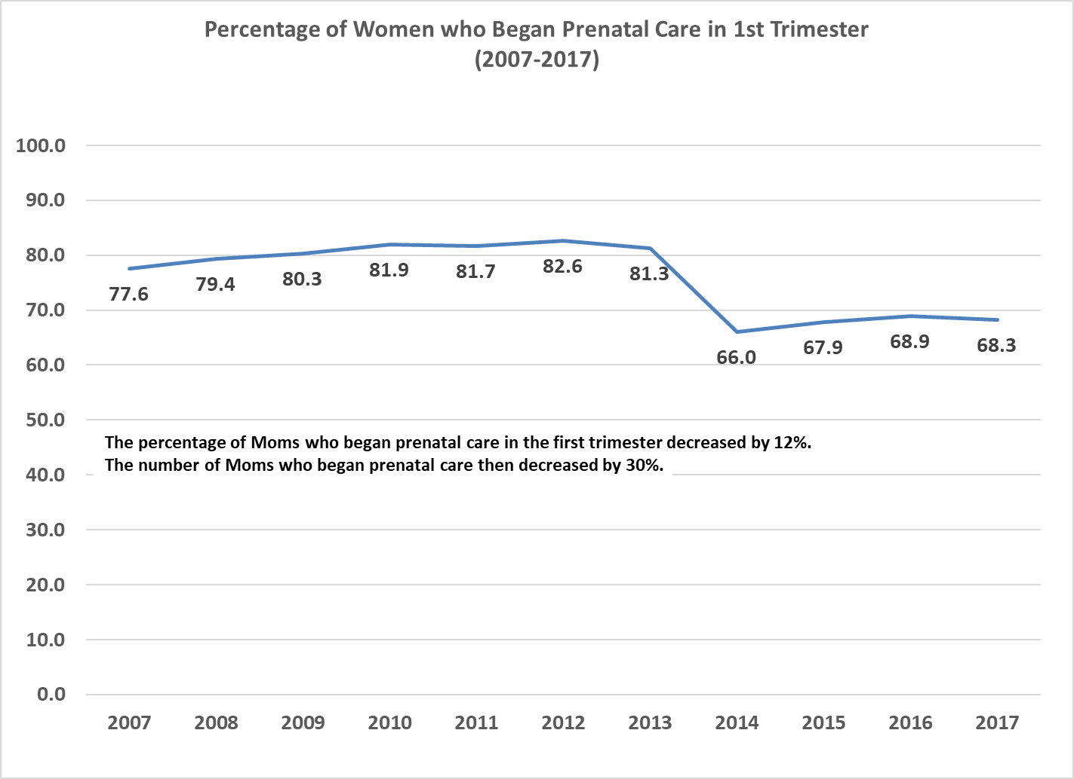
Percentage of Arizona Moms who began prenatal care in first trimester decreased by 12%.
Napolitano
Brewer
Ducey

Slide 15
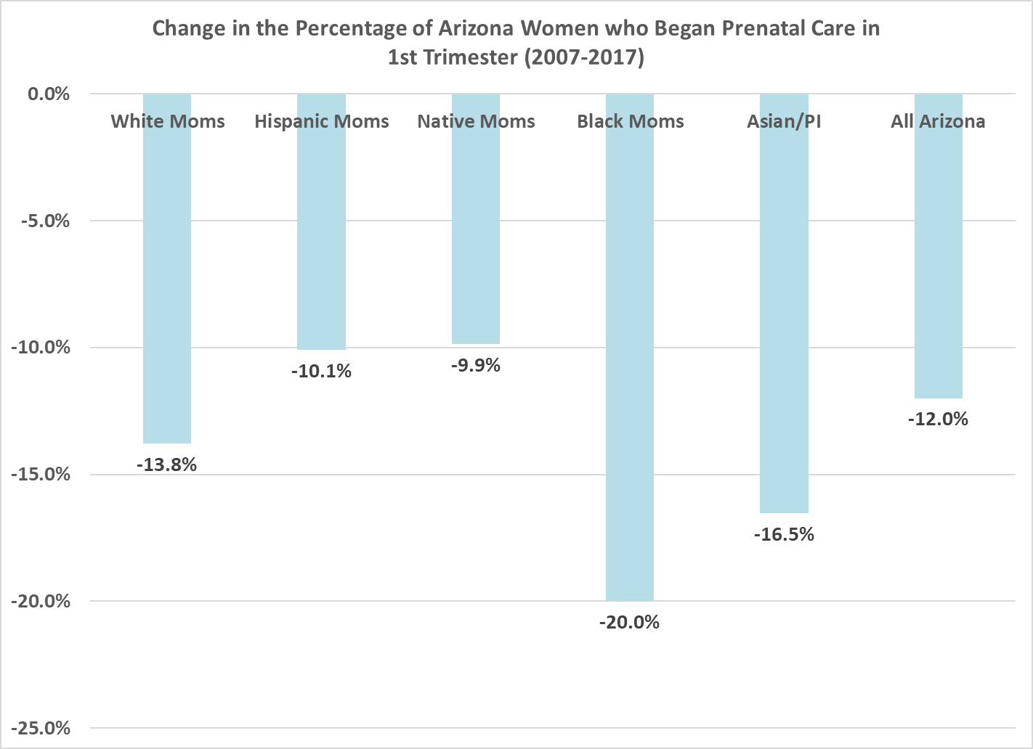
Percentage of Arizona Moms who began prenatal care in first trimester decreased across all races and ethnicities.

Slide 16
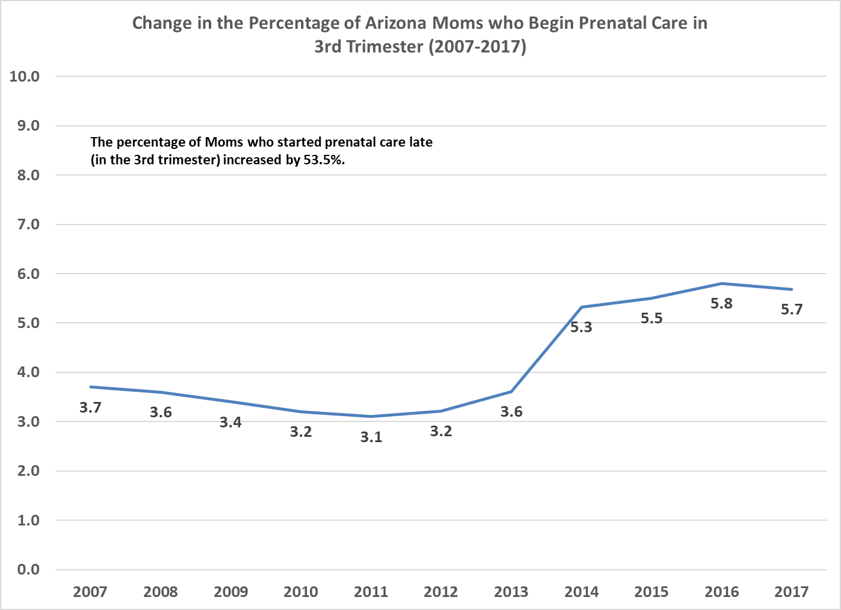
Percentage of Arizona Moms who began prenatal care in third trimester increased by 53.5%.
Ducey
Napolitano
Brewer

Slide 17
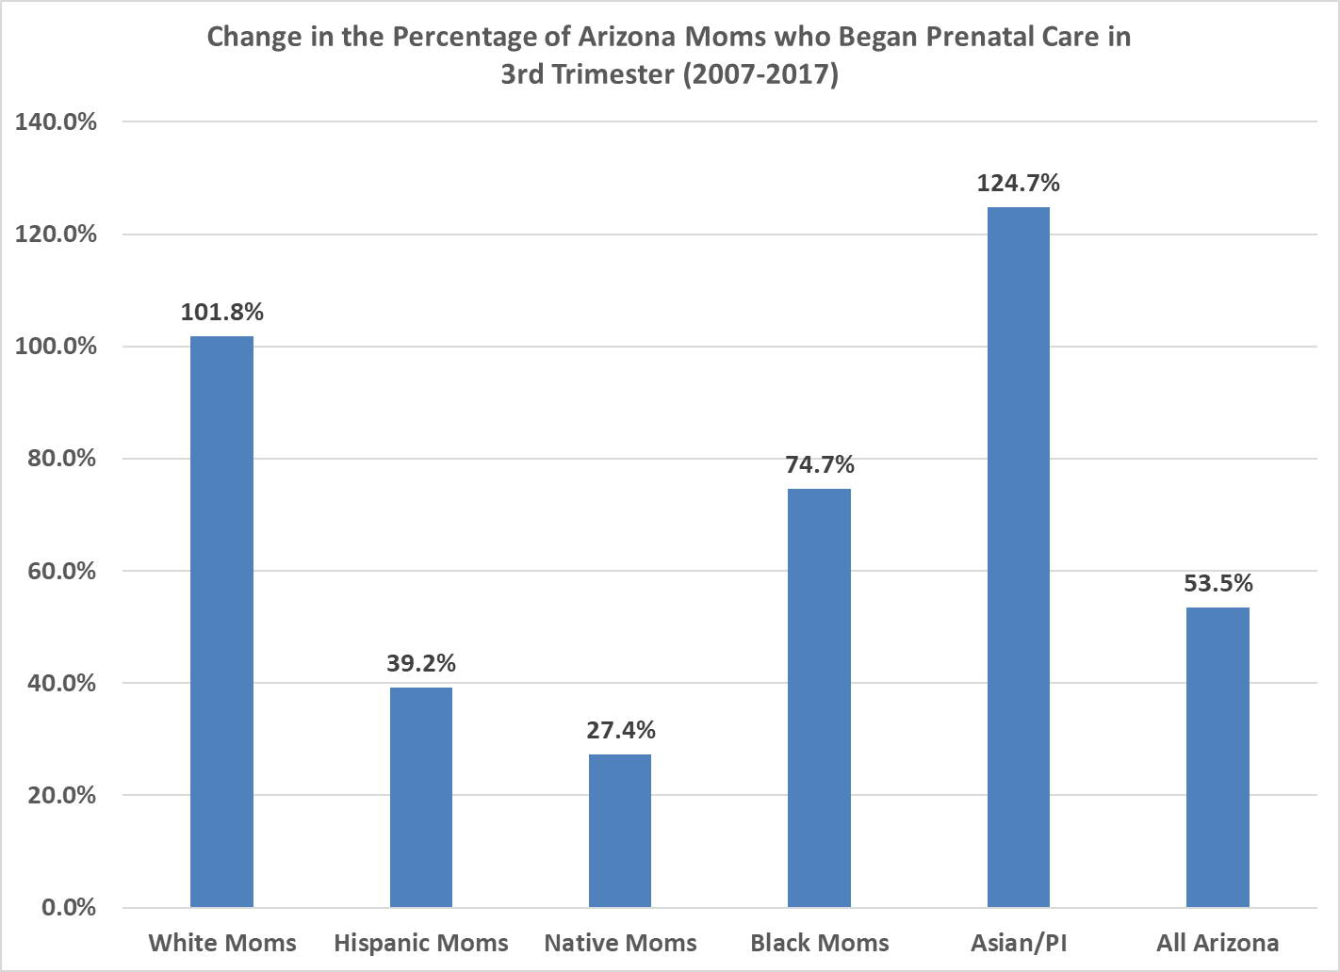
The percentage of Arizona Moms who began prenatal care LATE increased across all races and ethnicities.

Slide 18
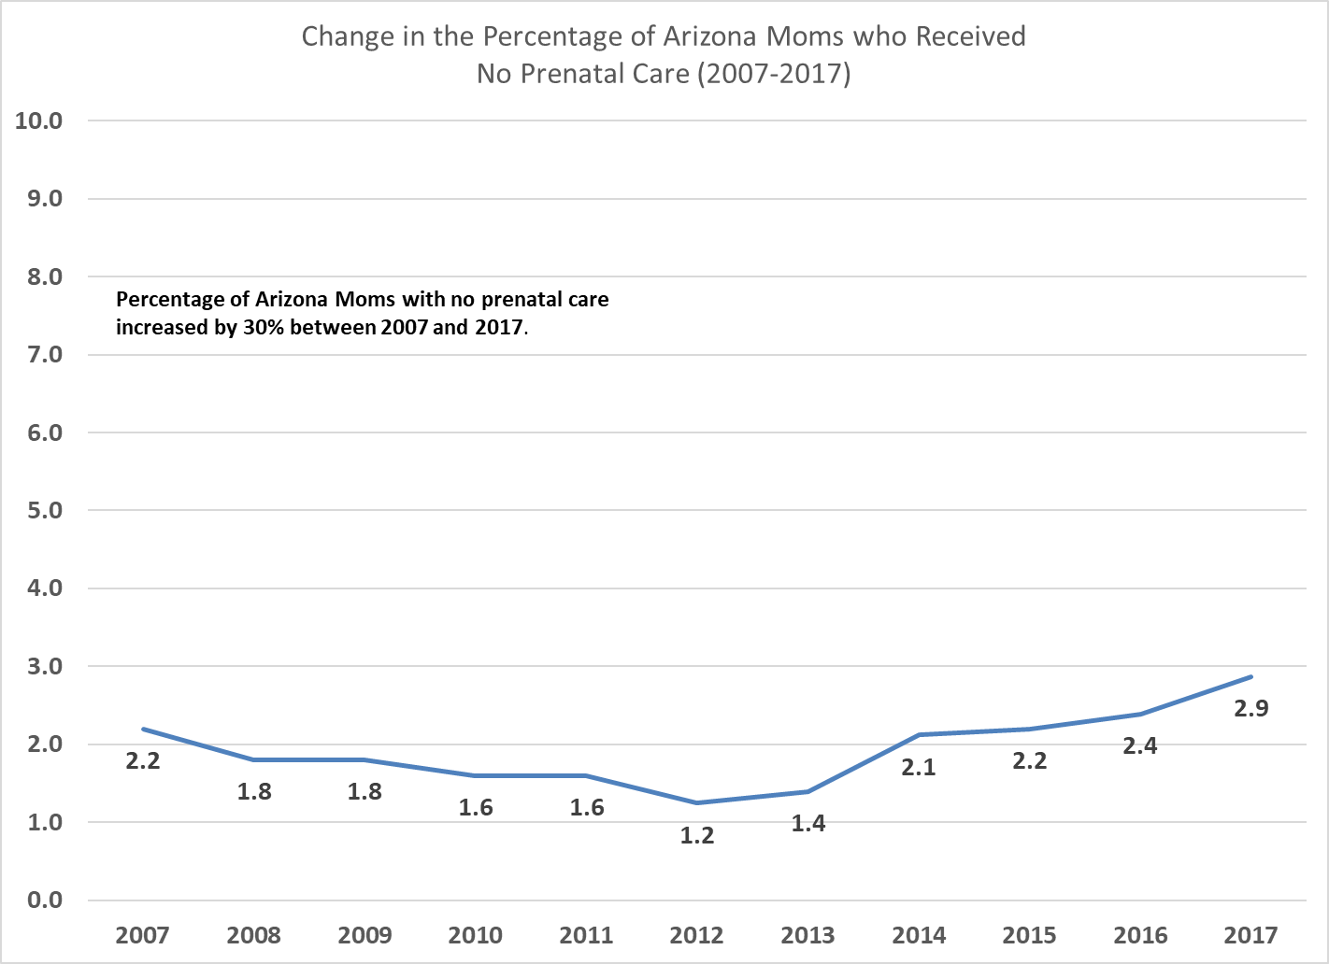
Percentage of Arizona Moms who had NO prenatal care increased by 30%.
Ducey
Napolitano
Brewer

Slide 19
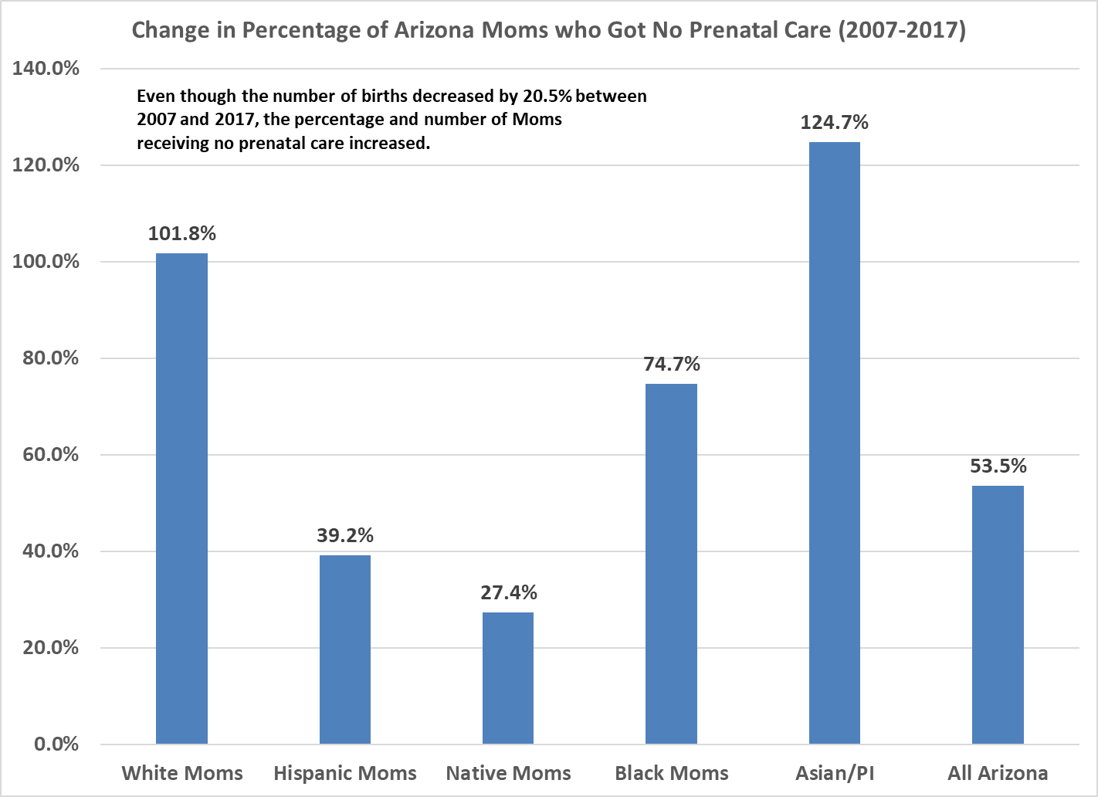
Percentage of Arizona Moms who had NO prenatal care increased across all races and ethnicities.

Slide 20
Ethnic & Racial Disparities in Birth Outcomes
In 2016, in Arizona…
Black Moms were most likely to have a preterm baby <37 weeks (12.4%)
(Native American 9.9%, Hispanic 9.2%, Asian/Pacific Islander 8.7%, White 8.5%, All Arizona 9.0%, Source: Arizona Department of Health Services)
Black Moms were most likely to have a low birth weight baby <2500 grams (12%) (Asian/Pacific Islander 9.3%, Native American 7.2%, Hispanic 7.1%, White 6.8%, All Arizona 7.3%, Source: Arizona Department of Health Services)
Nationwide…
Black Moms are three to four times more likely to die from pregnancy-related causes than white Moms. That hasn’t changed in 100 years! (Source: America’s Health Rankings)
American Moms are more likely to die from pregnancy-related causes than Moms from other developed countries. (Source: America’s Health Rankings)

Slide 21
It’s not all bad news
Comparing 2007 – 2017:
  51% decrease in percentage of Moms under 19
  26.8% increase in percentage of Moms over 30
  1.2% decrease in percentage of unmarried Moms
  60.8% decrease in percentage of Moms with less than 9 years of education
  Percentage of babies born preterm decreased by 10.1% but still high. (In same time period, percentage of low birthweight babies increased by 5.4%.)

Slide 22
Cost of Premature Birth in AZ

Slide 23
Next steps
More data analysis
Stakeholder meetings to collect input and stories
Legislation for 2020

